Slide 1
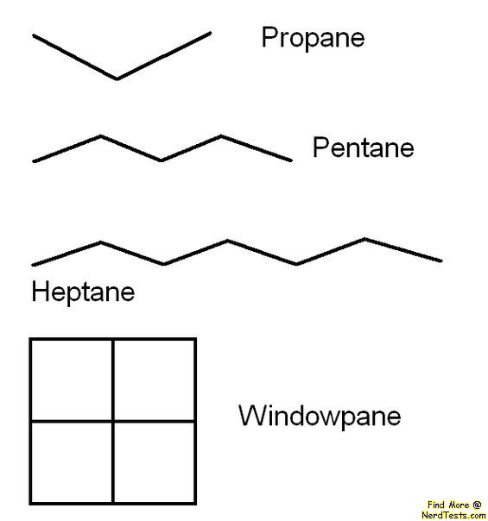

Slide 2
A1 Chemistry
Isomerism

Slide 3
Review
Alkanes contain only single bonds between carbons and have a general formula of CnH2n+2
Alkenes contain a double bond in the carbon chain and have a general formula of CnH2n

Slide 4
build a quiz - hydrocarbons

Slide 5
Learning Intentions
hydrocarbons, including alkanes, alkenes and benzene, have different chemical properties that are determined by the nature of the bonding within the molecules
IUPAC nomenclature is used to name straight and simple branched alkanes and alkenes from C1- C8

Slide 6
Success criteria
Define and give examples of structural, positional and geometric isomers
Draw all possible isomers for a particular formula, eg C₄H₈
Use cis and trans to name or draw alkenes

Slide 7
Key words
structural isomer(ism)
positional isomer(ism)
geometric isomer(ism)

Slide 8
Isomers
Isomers are different hydrocarbons (or other organic substances) that have the same molecular formula

Slide 9
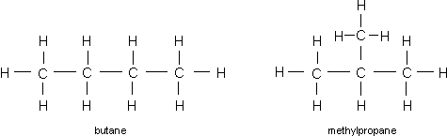
Structural Isomers
Different length of carbon chain
eg butane and methyl propane, C4H10

Slide 10
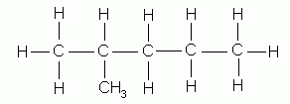
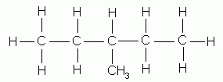
Positional Isomers
Different location for alkyl sidechains (or other functional groups) or double bonds
eg 2 – methyl pentane and 3 – methyl pentane
C6H14

Slide 11
Geometric Isomers
Some alkenes exhibit a special type of isomerism due to the inability of the double bond to rotate.
Occurs when there is asymmetry on both sides of the bond

Slide 12
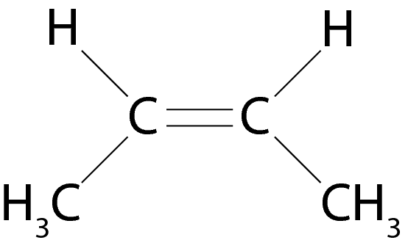
cis Isomers
The main carbon chain bends in the same direction away from the double bond

Slide 13

trans Isomers
The main carbon chain extends on either side of the double bond

Slide 14


Slide 15
Success criteria
Define and give examples of structural, positional and geometric isomers
Draw all possible isomers for a particular formula, eg C₄H₈
Use cis and trans to name or draw alkenes

